Slide 1
16CSE09 / Machine Learning Techniques
Unit – 2
CO-2: Utilize regression and classification algorithms
Sessions – 2
Topics:
Overview of Regression
Types of Regression

Slide 2
Regression
Regression model estimates the nature of the relationship between the independent and dependent variables.
Change in dependent variables that results from changes in independent variables, ie. size of the relationship.
Strength of the relationship.
Statistical significance of the relationship

Slide 3
Regression (Cont…)
Dependent variable is employment income – independent variables might be hours of work, education, occupation, sex, age, region, years of experience, unionization status, etc.
Price of a product and quantity produced or sold:
Quantity sold affected by price. Dependent variable is quantity of product sold and independent variable is price.

Slide 4
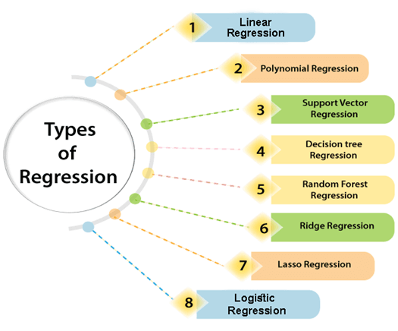
Types of Regression

Slide 5
Bivariate and multivariate models
Bivariate or simple regression model
(Education) x y (Income)
(Education) x₁
(Sex) x₂
(Experience) x₃
(Age) x₄
Multivariate or multiple regression model
y (Income)

Slide 6
Uses of regression
Regression analysis is a statistical method to model the relationship between a dependent (target) and independent (predictor) variables with one or more independent variables.
More specifically, Regression analysis helps us to understand how the value of the dependent variable is changing corresponding to an independent variable when other independent variables are held fixed.
It predicts continuous/real values such as temperature, age, salary, price, etc.

Slide 7
Uses of regression (cont…)
Amount of change in a dependent variable that results from changes in the independent variable(s) – can be used to estimate elasticities (percentage change of one economic variable in response to a change in another.), returns on investment in human capital, etc.
Prediction and forecasting of sales, economic growth, etc.
Support or negate theoretical model.

Slide 8
Terminologies Related to the Regression Analysis
Dependent Variable: The main factor in Regression analysis which we want to predict or understand is called the dependent variable. It is also called target variable.
Independent Variable: The factors which affect the dependent variables or which are used to predict the values of the dependent variables are called independent variable, also called as a predictor.
Outliers: Outlier is an observation which contains either very low value or very high value in comparison to other observed values. An outlier may hamper the result, so it should be avoided.

Slide 9
Terminologies Related to the Regression Analysis
Multicollinearity: If the independent variables are highly correlated with each other than other variables, then such condition is called Multicollinearity. It should not be present in the dataset, because it creates problem while ranking the most affecting variable.
Underfitting and Overfitting: If our algorithm works well with the training dataset but not well with test dataset, then such problem is called Overfitting. And if our algorithm does not perform well even with training dataset, then such problem is called underfitting.

Slide 10
Summary
Overview of Regression & its Use
Types of Regression and the Terminologies of Regression Analysis
Thank You

